Slide 1

Hbase Practice At ke.com
Guoxian Zhao

Slide 2
Content
01
Architecture Evolution
02
Olap Scenario
03
Monitor Scenario
04
Data Mining Scenario
05
Reatime ETL Scenario
06
Hdic Scenario

Slide 3
Architecture Evolution
01

Slide 4
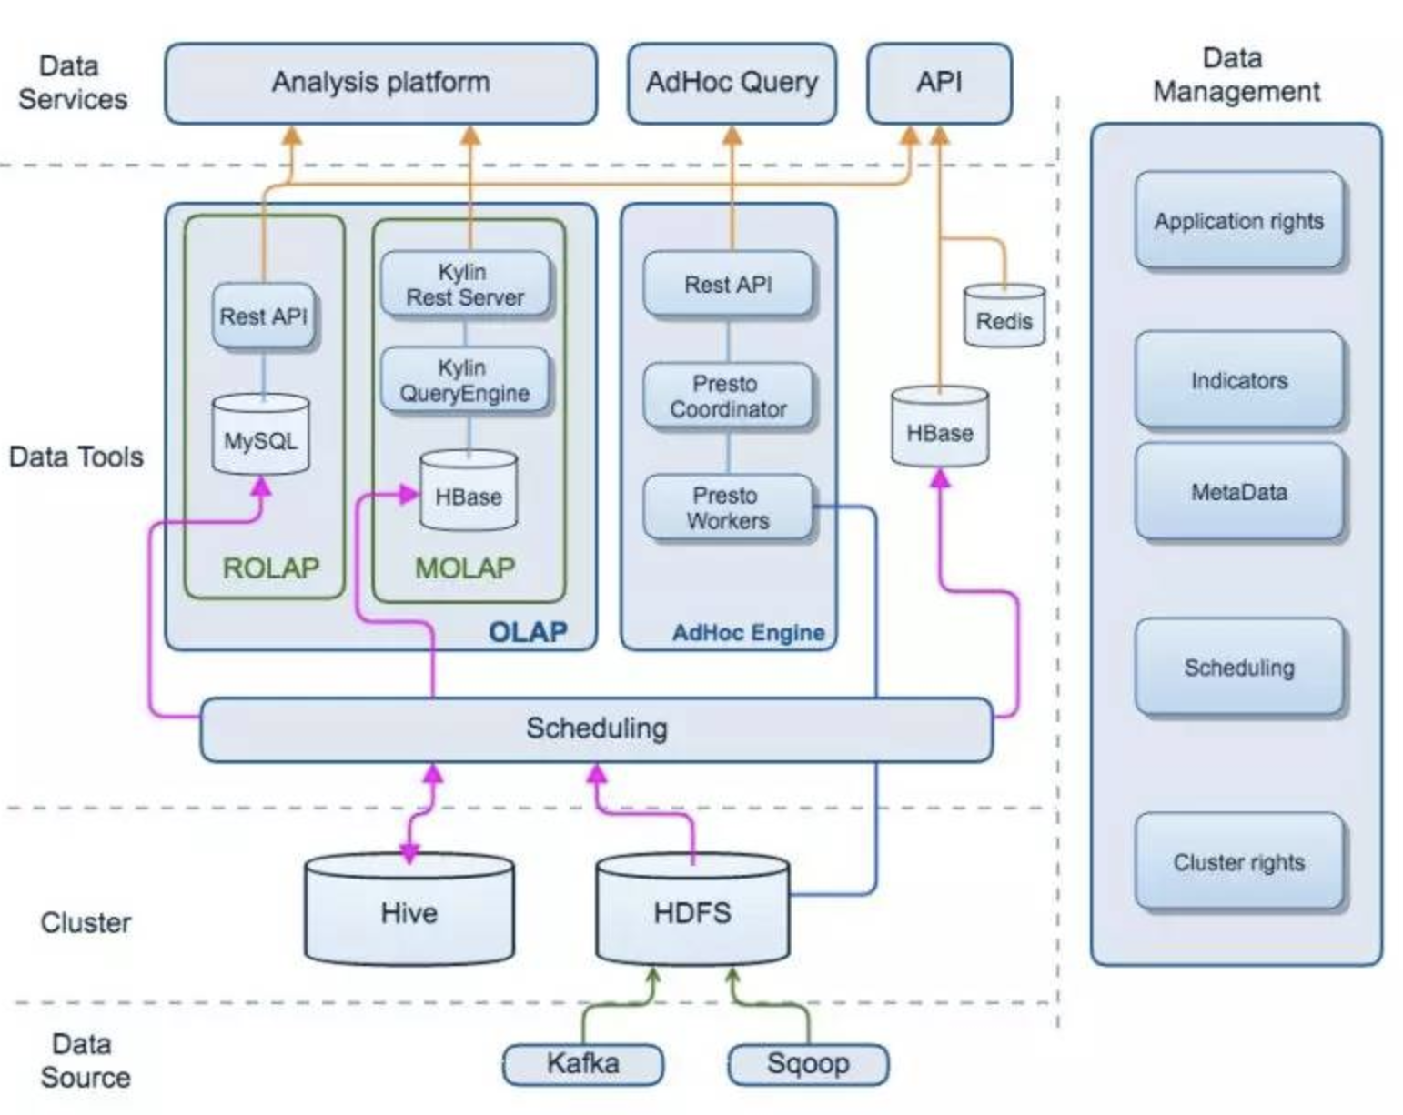
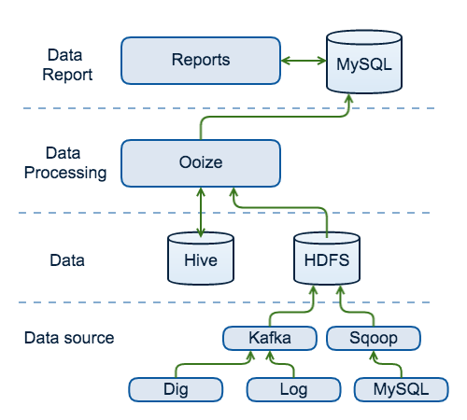
bigdata architecture for ke
Evolution

Slide 5
Olap Scenario
02

Slide 6




Olap Scenario
Requirement List
Billion data set
High concurrency
subsecond response times
sql interface

Slide 7
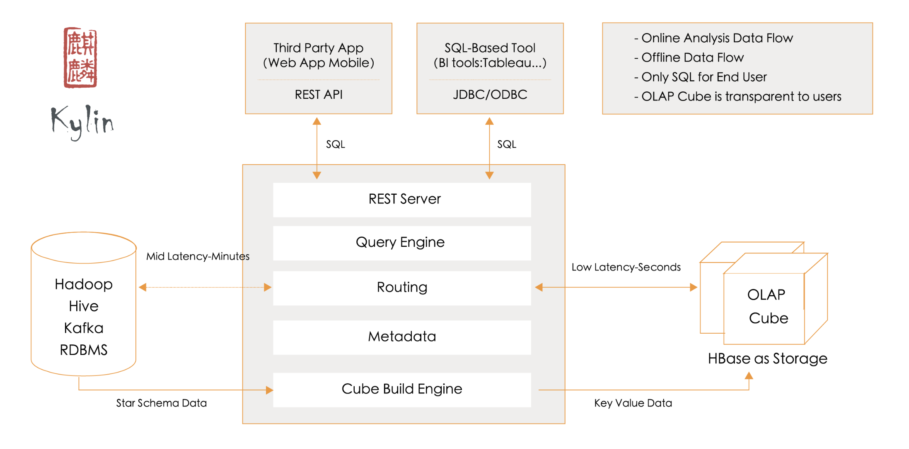
Olap Scenario
kylin

Slide 8
Olap Scenario
Olap data architecture map
product
Metrics api
redis
redis
query
Cube execute
permission
adhoc
Meta manager
Statistics
queryengine
Kylin middleware
monitor
presto
Sparksql
Offline kylin
zk
nginx
Spark cluster
meta
build
build
query
query
Alluxio
hadoop, warehouse + compute
…
Hbase
…
scheduler
load

Slide 9
Data For Kylin
800+cube、16+business
200T storage、160000 million data、1 cube 6000 million
Query/day million， <500ms(95%), <1s (99%)

Slide 10
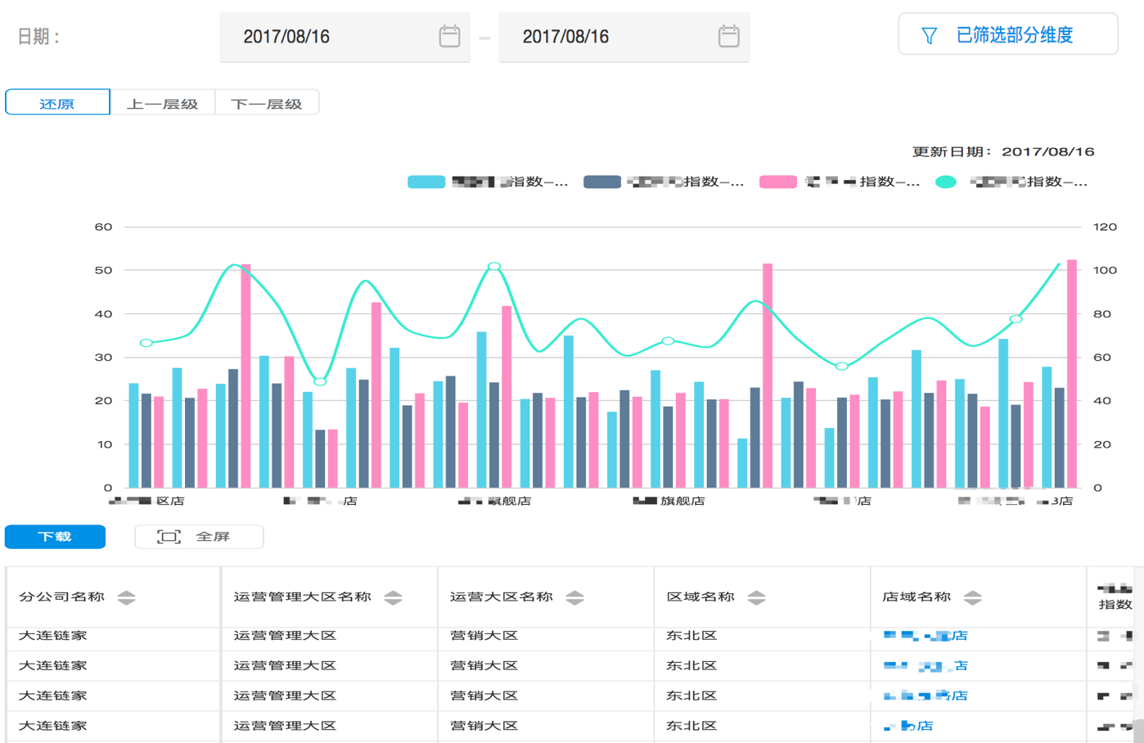
Data Product
Metrics platform
roll-up drill
multidimensional analysis
self-service configuration report
standard indices

Slide 11
Performance Optimizations For Hbase
SSD-FIRST
Client
OR
Read remote ssds first
HDD
S
S
D
HDD
DN1
DN2
DN3

Slide 12
Performance Optimizations For Hbase
others
HDFS short-circuit
Data hedged ，multi thread read
Test stale datanodes, avoid the slow datanode
Shutdown balance
Multiwal， Improve write performance

Slide 13
Monitor Scenario
03

Slide 14
Monitor senario
grafana
TeleGraf
TSD
Task metrics
HAProxy
HBASE
Hadoopmetrics
TSD

Slide 15
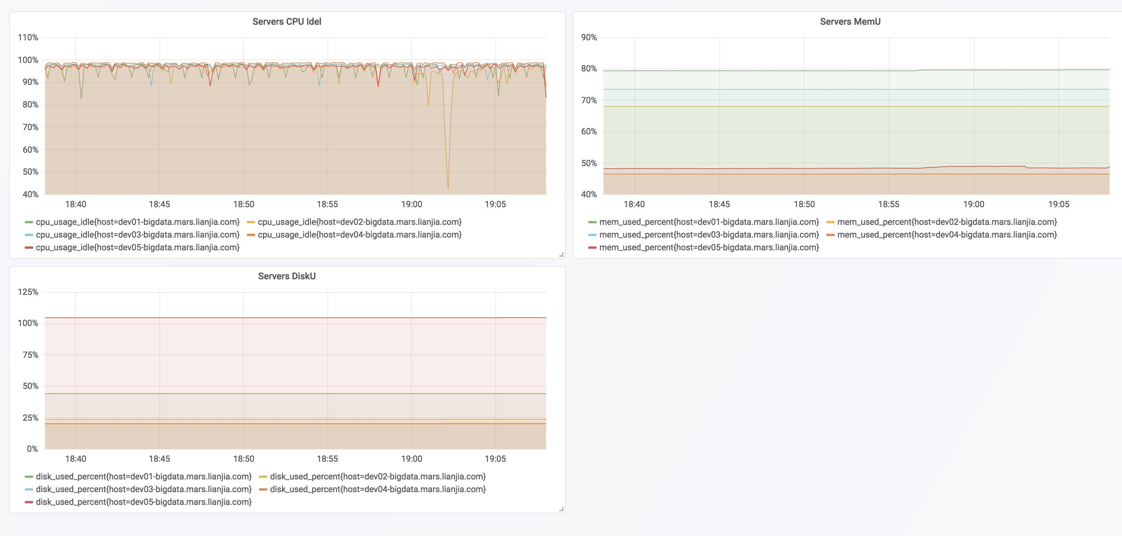
Monitor Scenario

Slide 16
Data Mining Scenario
04

Slide 17
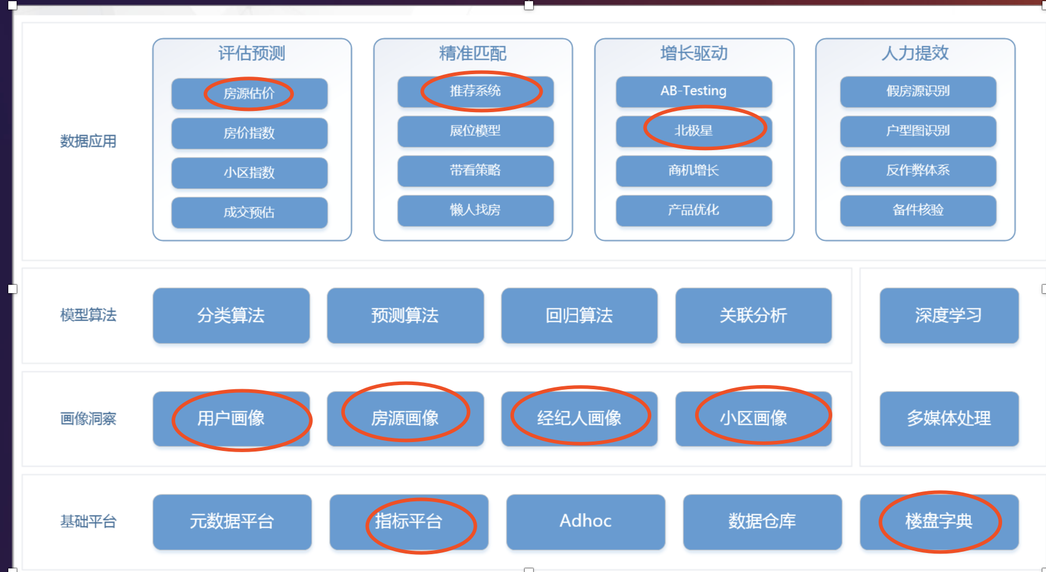
Data Mining Scenario

Slide 18
RealTime ETL Scenario
05

Slide 19
RealTime ETL Scenario
Subtitle Text
RealTime DB ETL
RealTime log ETL
HBASE
fast write
fast read
change record
bigdata storage
3
4

Slide 20
Hdic Scence
06

Slide 21
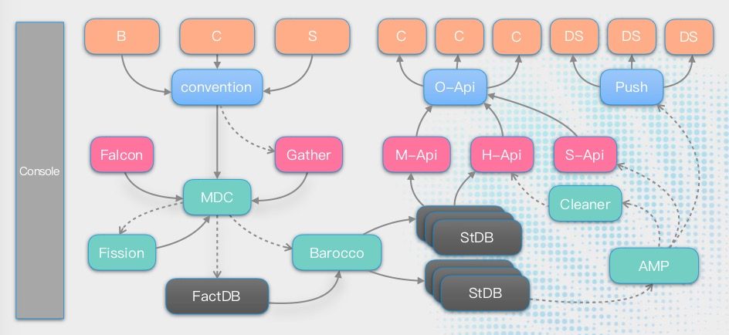
Hdic Scenario
Subtitle Text
3
4

Slide 22
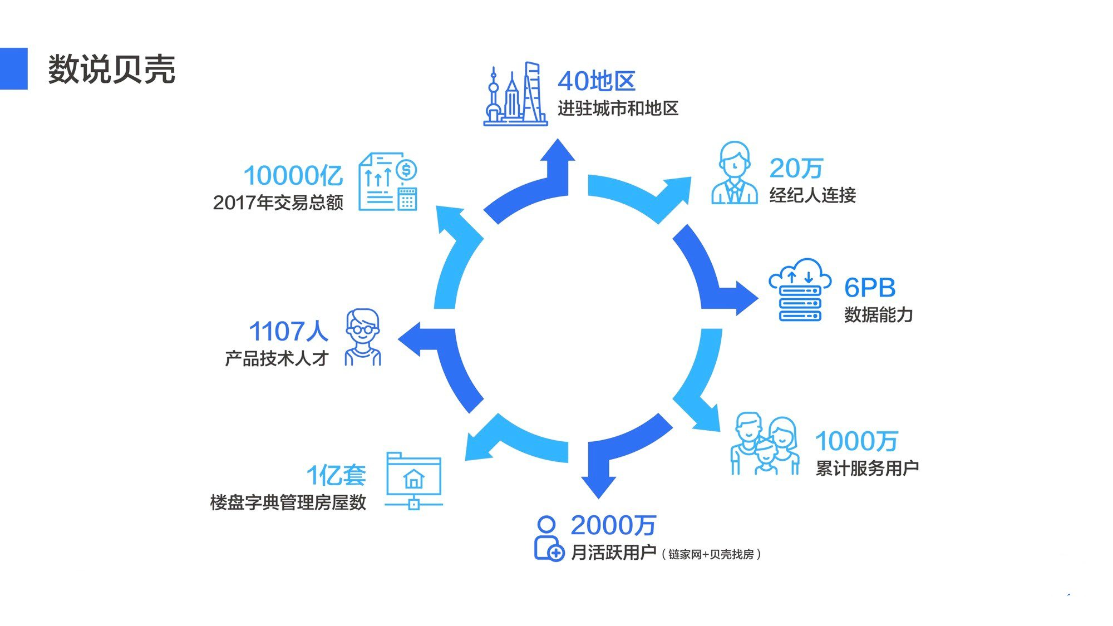
Data For Ke

Slide 23
Thanks

